Slide 1

Breaks….I can go and go and go because I like the topics. Please stop me at 90min!
I will try to do 10min breaks at 90min intervals!

Slide 2
Instruction Paradigm
In R
Day 1
Day 2
Obtain
Scrub
Explore
Model
Interpret
Also reviewed in Python
Obtain
Expanded
Scrub
Explore
Model
Interpret
Production

Slide 3
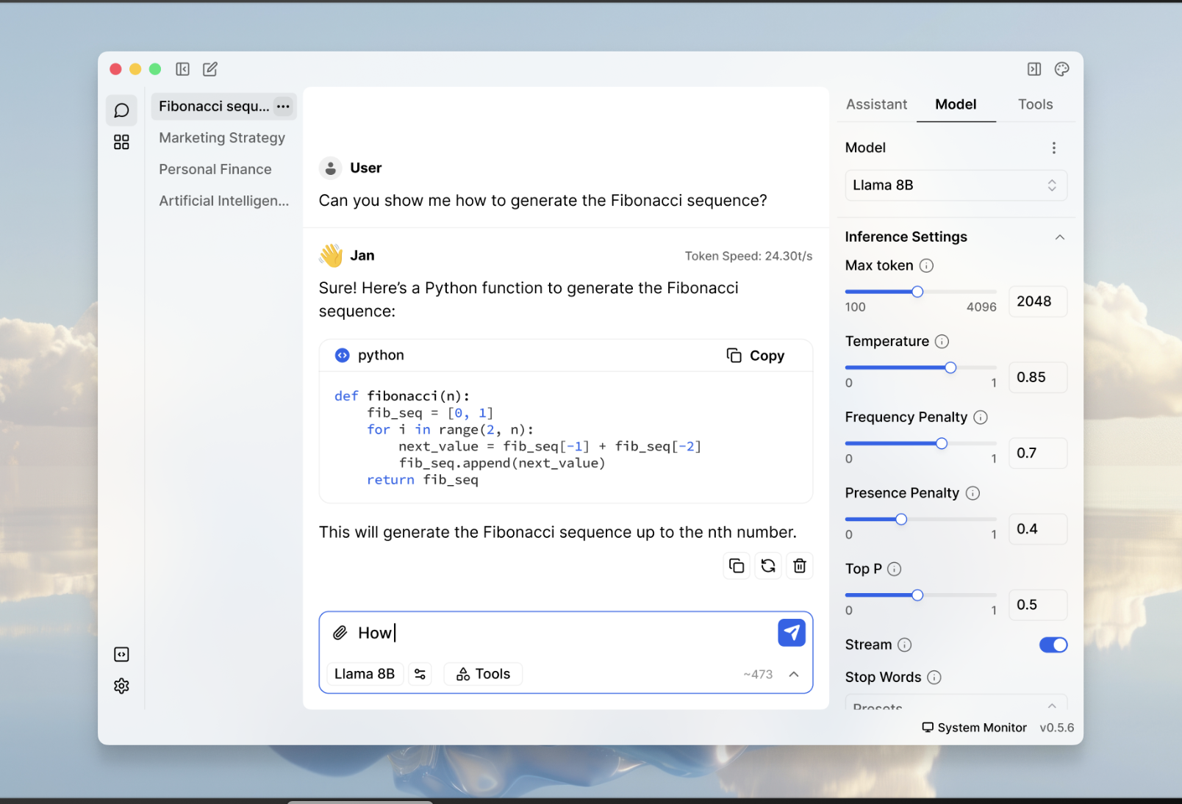
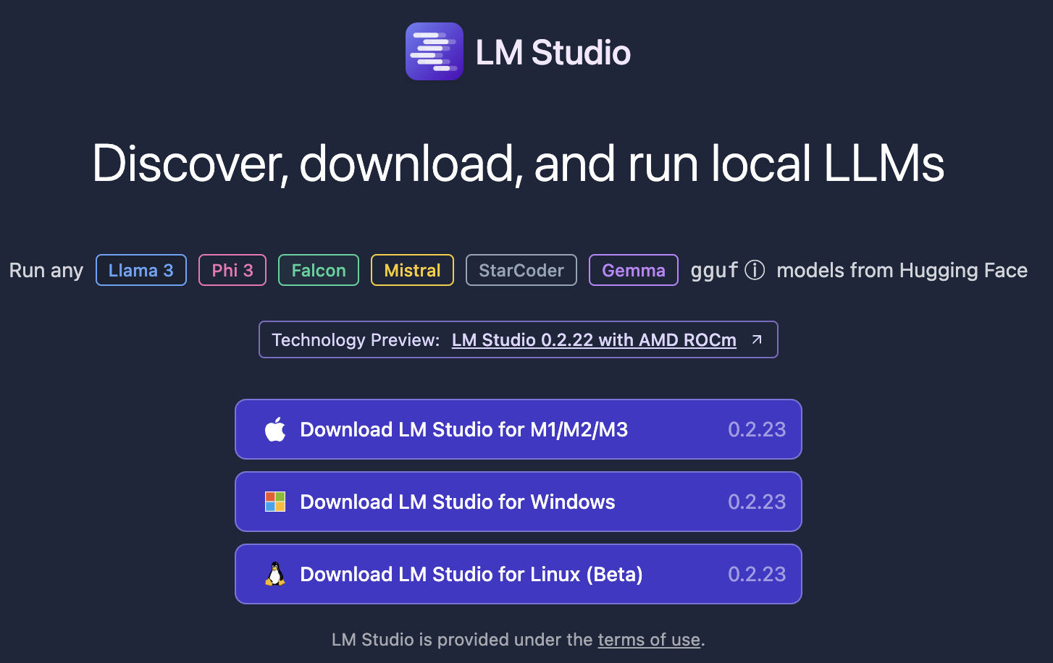
The course uses three four software components for learning.
In the next sections, skip to the method you want to use Local (Mac or Windows, Virtual Machine, Cloud/Hosted)
Integrated Development Environment
Version Control & file sharing
Statistical Software
Run local LLMs
The class will use LM-Studio or Jan.AI, but alternatives could be LM-Studio or if you know about APIs any LLM service (openAI)

Slide 4


Your Data Mining Toolbox
Previous Lessons
Some R Programming
Knowledge of Data Preparation
Exploratory Data Analysis
Basic Visualization
After today
You can predict continuous business outcomes using linear regression
You can predict binary classification with logistic regression
You have a basic understanding of LLMs
Regression is an initial starting algorithm. It puts you on a path to more complex machine learning but more importantly you can start to frame business problems in terms algorithms can understand.

Slide 5
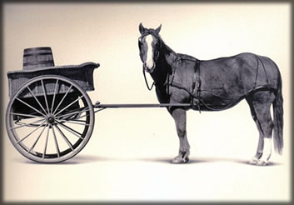
Let’s Practice
Open A_Regression.R
Predict Diamond Prices with linear regression.

Slide 6


Slide 7
The Problem of Overfitting
Statistical models can produce highly complex explanations of relationships between variables
The “fit” may be excellent
When used with new data, models of great complexity may do not do so well.
Notes:
7

Slide 8
100% fit – not useful for new data
Notes:
8

Slide 9
Another view of overfitting to a problem…

Slide 10
Overfitting, continued.
Causes:
Too many predictors start to inject noise not signal
Not adhering to a priori partitioning – up next
Lack of data knowledge & problem understanding
Consequence: Deployed model will not work as well as expected with completely new data.

Slide 11
Minimize Overfitting - Partitioning
Divide data into training portion and validation portion
Test model on the test portion
Training Data
All Data
Test Data
Notes:
How do you want to “spend” data

Slide 12
Minimize Overfitting - Partitioning
Divide data into training portion , validation & test portions
Tune a model and/or compare models with the validation portion
The “true” way a model will behave when launched on new data.
Training Data
All Data
Validation
Data
Test Data
Notes:
How do you want to “spend” data

Slide 13
Best Practice
If you have enough data and the model impact is large, this is a good partitioning schema
However, this much effort is not always undertaken.
Feature Engineering
Data
Training Data
All Data
Validation Data
Test Data
Notes:
How do you want to “spend” data
For large data – production, 10% improvement = $500M; 10% overfitting = $-500m
Additional layer of partitionoing CV discussed later

Slide 14
Review
Data Mining:
Supervised - Classification & Prediction
Unsupervised- Association Rules, Data Reduction, Data Exploration & Visualization
Before algorithms can be applied, data must be explored then pre-processed (treated)
To evaluate performance and to avoid overfitting, data partitioning is used
Models are fit to the training partition and assessed on the validation and test partitions
Today’s lesson explores partitioning and simple prediction.

Slide 15


Supervised Learning
Inferring a function from labeled data.
“Learn from telling”, “Look at my data and I will tell you what to predict”
Data Setup
Algorithm
Business Context
Application
Marketing-Will a customer buy yes or no? How much will a customer spend?
Operations- Will an applicant default? When will a machine break?
Sports Analytics- How many points will the Bears’ QB score? What is the Bears’ probability of winning?
Requires expertise and stakeholder buy in
Flat “Excel” file. Each row is a record or observation. Each column is an attribute of the record.
One column is the outcome, y or target attribute.
Modeling e.g. K-NN, linear regression, decision tree, random forest etc.
Use the model to make predictions for the target label on the new data.

Slide 16

Supervised Learning Example
Inferring a function from labeled data.
“Learn from telling”, “Look at my data and I will tell you what to predict”
What impacts ice cream sales?
#
=ƒ(…)
Notes:
Just did carat to diamond prices
Now let’s add more than 1 input

Slide 17
Linear Regression for continuous outcomes
#
= $β$ + ($β$*temperature) + ($β$*day) + ($β$*price) + error
Some linear combination of temperature values, day of the week dummy variables and price estimate the number of cones that will sell.
Notes:
What should we expect the beta signs to be? Whats the relationship the information has with ice cream sales?
Temp goes up? Sales go up. Temp goes down? Sales go down. Positive relationship
Price goes up? Sales go down. Price goes down? Sales go up. Negative relationship

Slide 18
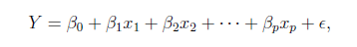
The linear combination equation captures information
outcome
coefficients
constant
error (noise)
predictors

Slide 19
The linear combination equation captures information
Outcome:
The “dependent”, “y” or “target”.
Number of Ice Cream Cones

Slide 20
The linear combination equation captures information
Constant:
The “intercept” or “beta-naught” has no predictor associated with it.
Avg. Number of Ice Cream Cones expected to sell if predictors were all 0.

Slide 21
The linear combination equation captures information
Predictors:
The “informative features”, “x” or “independent” variables.
Variables affecting sales in the data, temp, day, & price.

Slide 22
The linear combination equation captures information
Coefficients:
The “weight”, “betas” or “coefficients” multiplied with the specific “x” variable value.

Slide 23
The linear combination equation captures information
Error:
The “error” or “noise” represents the value the equation is wrong compared to the actual Y.

Slide 24
The linear combination equation captures information
outcome
coefficients
constant
error (noise)
predictors
The combinations of beta coefficients seeks to minimize the squared errors between the actual Y values and the equation. This combination manifests as the “best fit line”

Slide 25
#
= $6$ + 0.$25$*temperature + $3$*satudray_dummy + -0.5*price
Beta-Naught | Temperature | Saturday_dummy | Price
6 | 0.25 * 80 degrees | 3 * 1 | -0.5 * 5
6 | 0.25 * 88 | 3 * 0 | -0.5 * 2

Slide 26
#
= $6$ + 0.$25$*temperature + $3$*satudray_dummy + -0.5*price
Beta-Naught | Temperature | Satuday_dummy | Price | Best Fit Prediction
6 | 0.25 * 80 degrees | 3 * 1 | -0.5 * 5 | 26.5
6 | 0.25 * 88 | 3 * 0 | -0.5 * 2 | 27

Slide 27
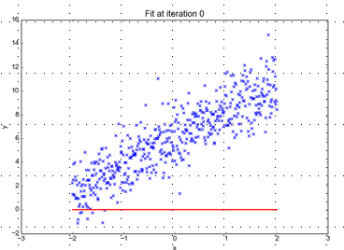
Minimizing the Sum of Ordinary Least Squared Errors
Equation:
Y= 0 +(0*x)
Beta “Naught” = 0
Intercept is 0
X beta coefficient = 0
No slope
Blue points Y Values represent actual outcome.
MINUS
Red line is the predicted outcome
Equals the Error

Slide 28
Big Errors
Equation:
Y= 0 +(0*x)
Beta “Naught” = 0
Intercept is 0
X beta coefficient = 0
No slope
Blue points Y Values represent actual outcome.
MINUS
Red line is the predicted outcome
Equals the Error

Slide 29
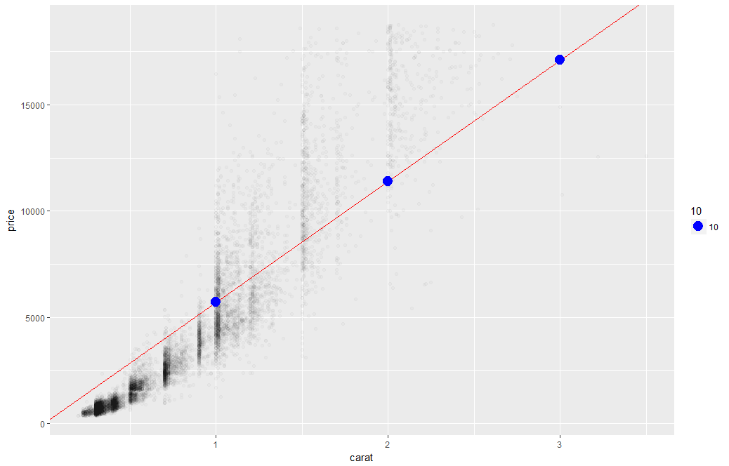
What’s really going on?
Errors between a prediction and actual.
Notice some are negative and some are positive

Slide 30
Why Squared Error?
Blue points Y Values represent actual outcome.
MINUS
Red line is the predicted outcome
Equals the Error
Cones
85
48
45
27
32
30
69
80
15
61
Prediction
67
42
54
95
1
48
51
95
20
22
Error
18
6
-9
-68
31
-18
18
-15
-5
39
-3
(18 + 6 + -9 + -68 + 31 + -18 + 18 + -15 + -5 + 39)
Notes:
Is this a good model?
18 + -18 cancel each other out

Slide 31
Why Squared Error?
Without squaring the errors positive & negative prediction errors cancel each other out.
(18² + 6² + -9² + -68² + 31² + -18² + 18² + -15² + -5² + 39²)
8445
324 + 36 + 81+ 4624 + 961 + 324 + 324 + 225 + 25 + 1521
Squaring the error means all errors have the same impact on the optimization function.
Notes:
Is this a good model?
18 + -18 cancel each other out

Slide 32
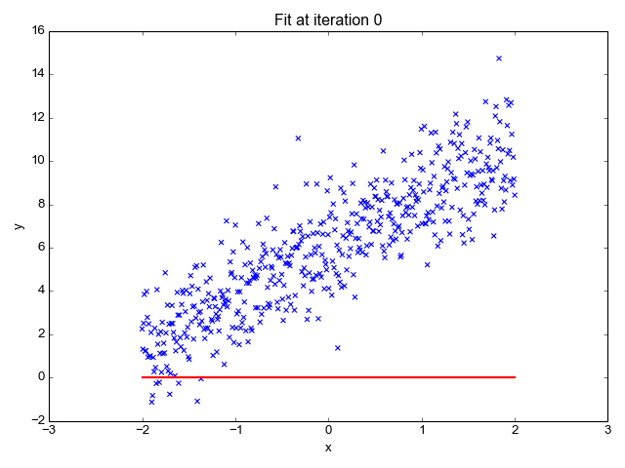
So what is really going on?
The algorithm is optimizing the inputs and weights (beta’s) to minimize the sum of squared errors.
This is called “ordinary least squares (OLS).

Slide 33
Let’s Practice
Open B_Regression_main.R

Slide 34
Explanatory Modeling
Goal: Explain relationship between predictors (explanatory variables) and target
Familiar use of regression in data analysis
Model Goal: Fit the data well and understand the contribution of explanatory variables to the model
“goodness-of-fit”: R², residual analysis, p-values

Slide 35
Predictive Modeling
Goal: predict target values in other data where we have predictor values, but not target values
Classic data mining context
Model Goal: Optimize predictive accuracy
Train model on training data
Assess performance on validation (hold-out) data
Explaining role of predictors is not primary purpose (but useful)

Slide 36
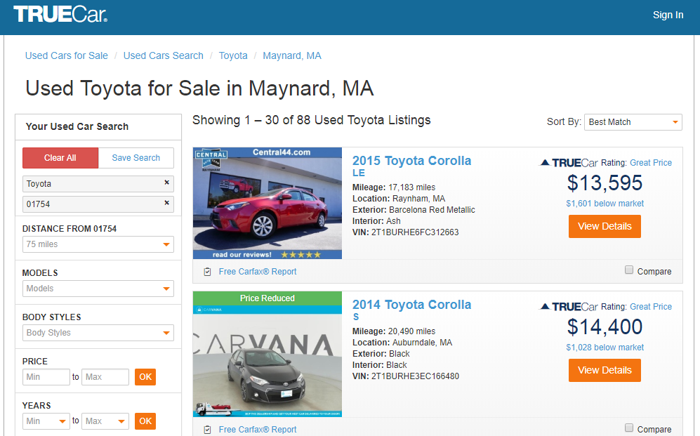
How does truecar.com know the price is “great?”

Slide 37

Yeah! I got a new job!

Slide 38

Welcome Dale to TrueCar’s Competitor: OldCar
Dale, can you predict used car prices? Then we will know if a car is priced above/below expected value

Slide 39

Let’s help Dale.
But of course. This sounds like a predictive modeling project.

Slide 40
Let’s practice.
Open C_oldCar.R
Price in Euros
Tires binary 0/1 are new tires on car
Age in months as of 8/04
KM (kilometers)
Fuel Type (diesel, petrol, CNG)
HP (horsepower)
Metallic color (1=yes, 0=no)
Automatic transmission (1=yes, 0=no)
CC (cylinder volume)
Doors
Quarterly_Tax (road tax)
Weight (in kg)
Using the preprocessing and partitioning code in your toolbox, create a linear model of Toyota prices.

Slide 41

Regression is susceptible to multi-colinearity
Math
The presence of two or more predictor variables sharing the same linear relationship with the outcome variable.
Don’t shock the cat by having multi-collinearity.
In other words
Two+ informative features are measuring essentially the same thing.
Example
When predicting ice cream sales you include Fahrenheit and Celsius temperatures as two separate informative features.

Slide 42

Regression is susceptible to multi-colinearity
What happens with multi-collinearity?
The effect is exaggerated e.g. double counted.
The good news
The problem is so prevalent/impactful that R’s linear regression function handles it.
Other algorithms are not affected by double counting
Best Practice
Even though R removes it, do not rely on the function. Understanding the data you put in will avoid “garbage in, garbage out” scenarios.
Make happy cats by
knowing your data.

Slide 43
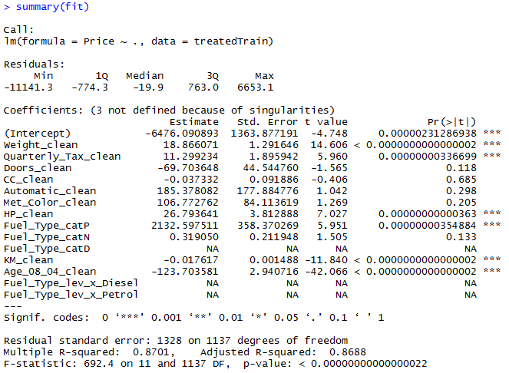
The Summary of the Fit

Slide 44
The Summary of the Fit
Auto ID of multi colinearity

Slide 45
The Summary of the Fit
Another name for errors.
Summary stats for the errors.

Slide 46
The Summary of the Fit
Treated Variable Names i.e. informative features

Slide 47
The Summary of the Fit
Coefficients or Beta values

Slide 48
The Summary of the Fit
P-Values
The probability of seeing a value larger than the t value.
Small p-values mean its less likely due to chance.

Slide 49
The Summary of the Fit
P-Values
In stats p <0.05 is good but in business I have seen p<0.2.
It’s a good idea to rebuild a model without variables that do not meet the cutoff.

Slide 50
The Summary of the Fit
P-Values
We could drop ??? Based on p values?
What variables should we drop with a p-value >=0.2?
Notes:
After slide back to script
CC_clean
Automatic_clean
Met_Color_clean
Fuel_Type_catP (prevalence) ie. 42% of the time that level appeared. X_catP =.42 for all level A observations.
GO BACK TO SCRIPT ~LINE60

Slide 51
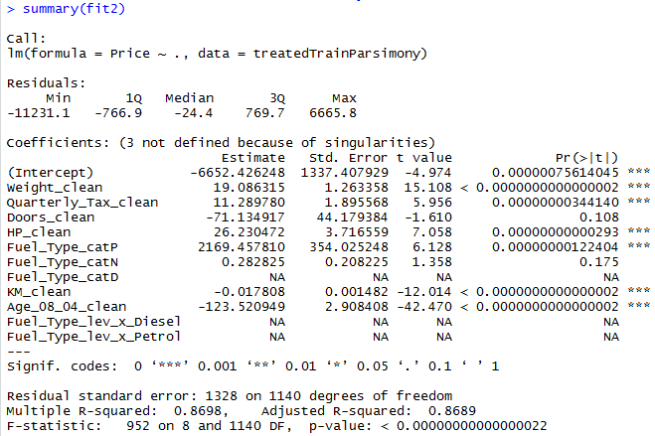
Parsimonious Model
Parsimony or compactness is desirable in models. The more features in a model, the more complexity we introduce, data integrity, data interactions, time to fit and time to predict are all impacted.
Notes:
We could drop yet another engineered variable but let’s continue. P =.175

Slide 52
Parsimonious Model
R-Sq: how much of the variation are the model is fitting. R-Sq measures the linear relationship between Price & features It always lies between 0 and 1
Notes:
We could drop yet another engineered variable but let’s continue.

Slide 53
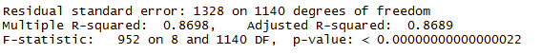
Compare the two models
fit1
fit2
It can be said that both models explain ~87% of the variation in car prices. Dropping the variables improved accuracy and reinforces the fact that the variables didn’t add value.

Slide 54
Evaluating a Prediction Model
RMSE- Root Mean Squared Error
y
y-hat
Actual Values | Predicted/Forecasted
10 | 16
12 | 8
20 | 17
36 | 34
Besides P-Values which is a variable level KPI, and adjusted R-Sq there are two popular KPI for evaluating continuous model predictions.

Slide 55
RMSE
RMSE- Root Mean Squared Error
y
y-hat
ERROR
ERROR-SQ
Actual Values | Predicted/Forecasted | Errors | Squared Errors
10 | 16 | -6 | 36
12 | 8 | 4 | 16
20 | 17 | 3 | 9
36 | 34 | 2 | 4
Mean
36+16+9+4
4
To manually calculate RMSE, work the acronym backwards.

Slide 56
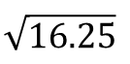
RMSE
RMSE- Root Mean Squared Error
ERROR
SQUARED
MEAN
ROOT
Actual Values | Predicted/Forecasted | Errors | Squared Errors
10 | 16 | -6 | 36
12 | 8 | 4 | 16
20 | 17 | 3 | 9
36 | 34 | 2 | 4
Mean
Square Root
36+16+9+4
$$\sqrt{16.25}$$
4
=4.03
In the same units being measured, tells you +/- the prediction error.

Slide 57

Back to script C
How good is Dale’s model?
Notes:
For the predict warning about rank deficient matrices:
Rank of the matrix is reduced since it throws out multi-collinear variables. Often can be safely ignored.

